Slide 1
Simulation of Two-wheeled Self-balancing Vehicle
Yuchen Song Ruoyao Tian Run He Jialong Zeng YanYifan Feng Hongjiao Yan

Slide 2
Part 1 Introduction
Part 2 System Model
Content
Part 3 LQR Design
Part 4 Simulation and Response
Part 5 Group Contribution

Slide 3
1
INTRODUCTION

Slide 4
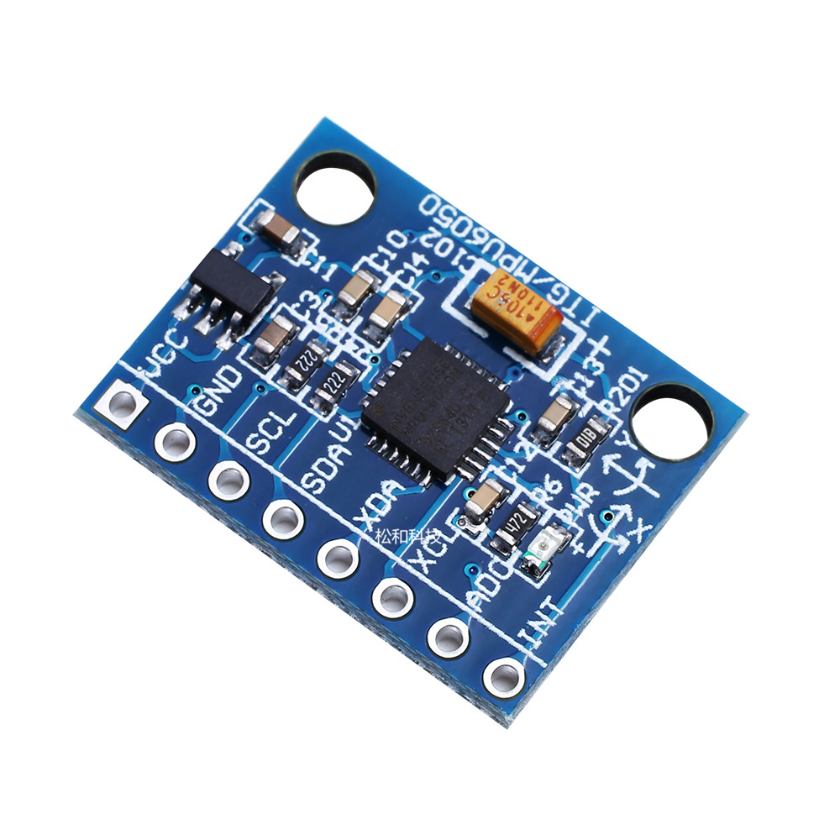
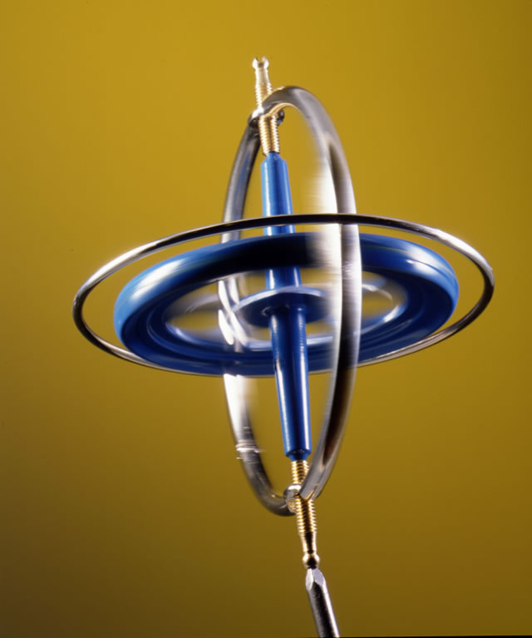
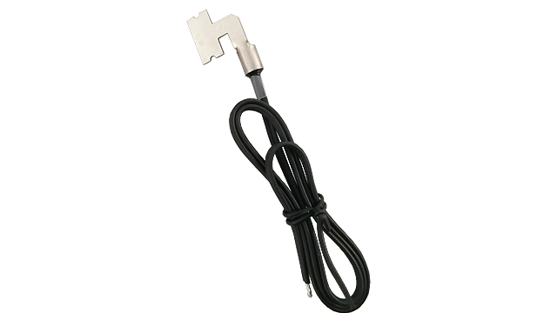
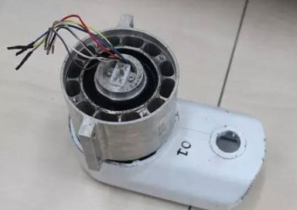
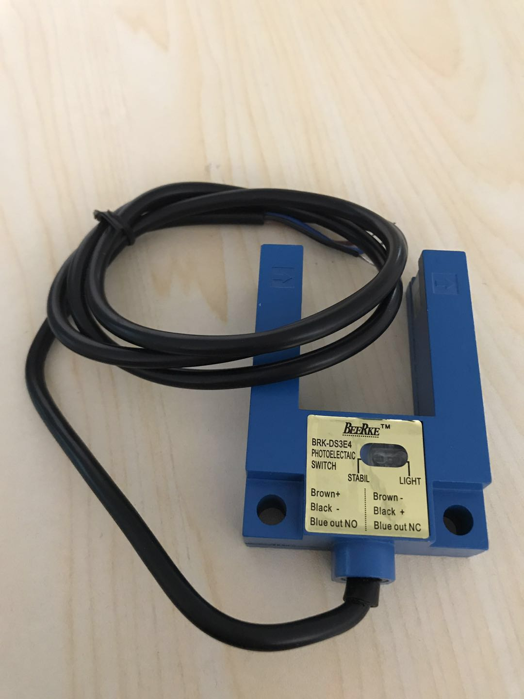
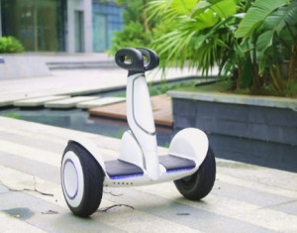
INTRODUCTION
At present, the most popular no. 9 electric balance vehicle, the core is mainly composed of three parts, respectively is the control module, drive module and sensor module.
Control module: (for example) STM32 MCU.
Drive module: servo motor, double winding resistance motor.
Sensor modules: accelerometer and gyroscope, photoelectric sensor, steering sensor and temperature sensor.

Slide 5
2
SYSTEM
MODEL

Slide 6
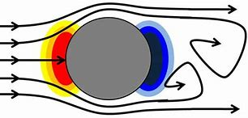
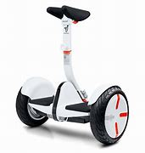
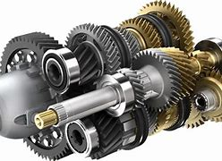
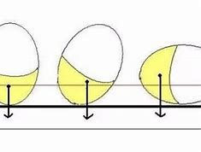

SYSTEM MODEL
01
02
Air Resistance
Friction between Parts
03
Center of Gravity Change
Irregular Shape
04
Reduce real objects to models

Slide 7
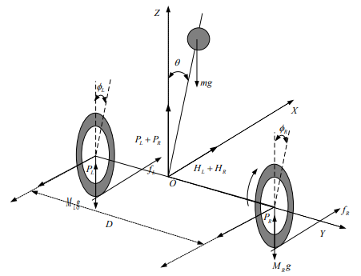
SYSTEM MODEL
Two wheels
Inverted pendulum
Two ideal motors
Wheel friction
Fig. 1 Mechanical balance analysis of two wheeled balancing vehicle. [1]

Slide 8
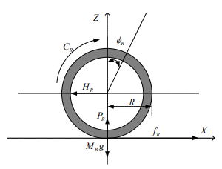
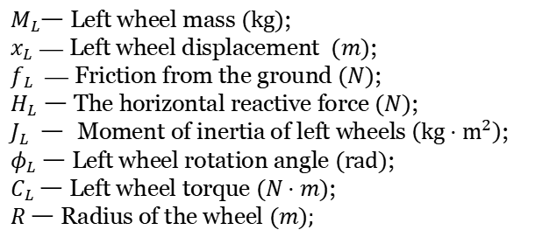

SYSTEM MODEL
$M_{L}$一 Left wheel mass $(kg)$; $x_{L}$ — Left wheel displacement $(m)$; $f_{L}$ — Friction from the ground $(N)$; $H_{L}$ 一 The horizontal reactive force $(N)$; $J_{L}$ 一 Moment of inertia of left wheels $\left(kg⋅m^{2}\right)$; $φ_{L}$ 一 Left wheel rotation angle $(rad)$; $C_{L}$一 Left wheel torque $(N⋅m)$; $R$ 一 Radius of the wheel $(m);$
EOMs of left wheel:
$$M_{L}{\dot{x}}_{L}=f_{L}−H_{L}$$
$$\begin{aligned}& \\ &J{\ddot{φ}}_{L}=C_{L}−f_{L}R\end{aligned}$$
Fig. 2 The force analysis of the right wheel of the self- balance scooter.[1]
The right wheel can be totally analogous.

Slide 9
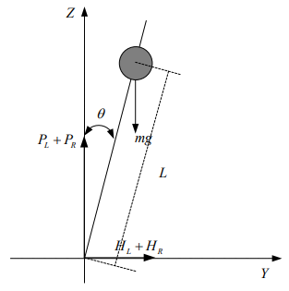
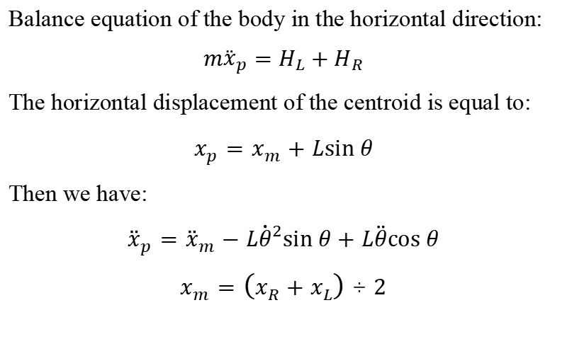
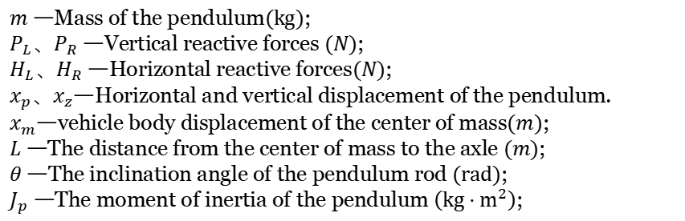
SYSTEM MODEL
$m$ 一Mass of the pendulum$(kg)$;
$P_{L}、P_{R}$ 一Vertical reactive forces $(N)$; $H_{L}、H_{R}$ 一Horizontal reactive forces$(N)$; $x_{p}、x_{z}$一Horizontal and vertical displacement of the pendulum.
$x_{m}$一vehicle body displacement of the center of mass$(m)$; $L$ 一The distance from the center of mass to the axle $(m)$; $θ$ 一The inclination angle of the pendulum rod $(rad)$; $J_{p}$ 一The moment of inertia of the pendulum $\left(kg⋅m^{2}\right)$;
Balance equation of the body in the horizontal direction:
$$m{\overset{¨}{x}}_{p}=H_{L}+H_{R}$$
The horizontal displacement of the centroid is equal to:
$$x_{p}=x_{m}+Lsin⁡θ$$
Then we have:
$${\overset{¨}{x}}_{p}={\overset{¨}{x}}_{m}−L{\dot{θ}}^{2}sin⁡θ+L\overset{¨}{θ}cos⁡θ$$
$$x_{m}=\left(x_{R}+x_{L}\right)÷2$$
Fig. 3 Transient mechanical analysis of body pendulum.[1]

Slide 10
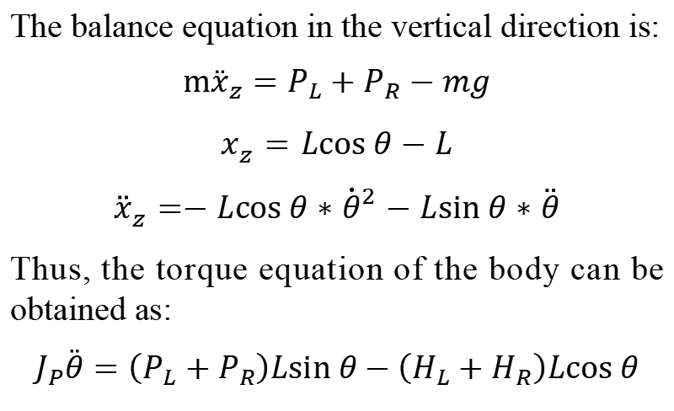
SYSTEM MODEL
The balance equation in the vertical direction is:
$$m{\overset{¨}{x}}_{z}=P_{L}+P_{R}−mg$$
$$x_{z}=Lcos⁡θ−L$$
$${\overset{¨}{x}}_{z}=−Lcos⁡θ∗{\dot{θ}}^{2}−Lsin⁡θ∗\overset{¨}{θ}$$
Thus, the torque equation of the body can be obtained as:
$$J_{P}\overset{¨}{θ}=\left(P_{L}+P_{R}\right)Lsin⁡θ−\left(H_{L}+H_{R}\right)Lcos⁡θ$$
Fig. 3 Transient mechanical analysis of body pendulum.[1]

Slide 11
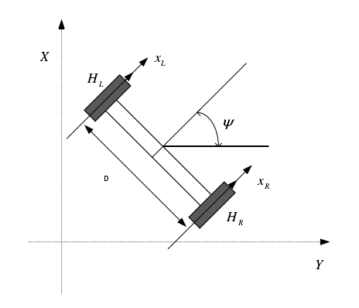
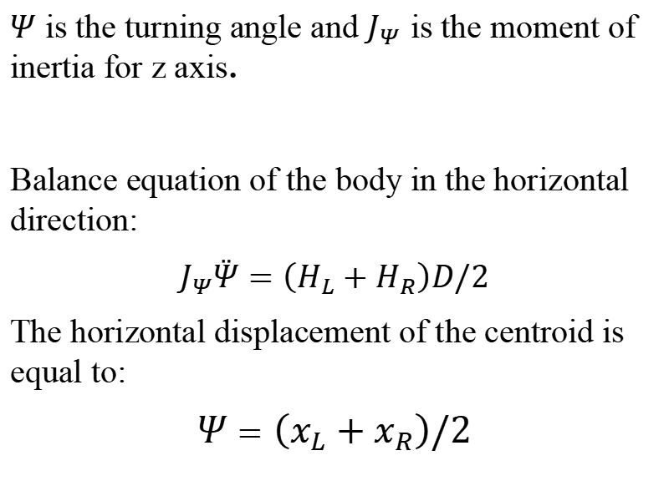
SYSTEM MODEL
$Ψ$ is the turning angle and $J_{Ψ}$ is the moment of inertia for z axis.
Balance equation of the body in the horizontal direction:
$$J_{Ψ}\overset{¨}{Ψ}=\left(H_{L}+H_{R}\right)D/2$$
The horizontal displacement of the centroid is equal to:
$$Ψ=\left(x_{L}+x_{R}\right)/2$$
Fig. 4 Analysis on turning.[1]

Slide 12
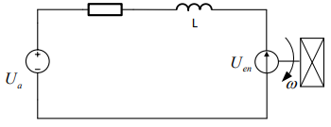
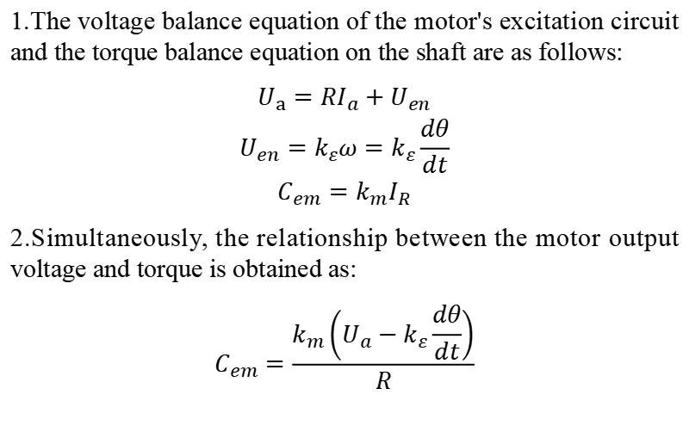
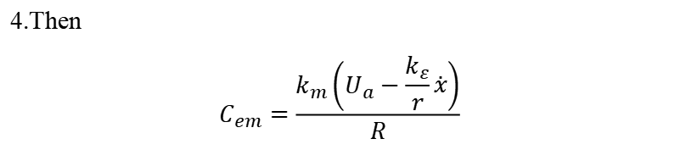
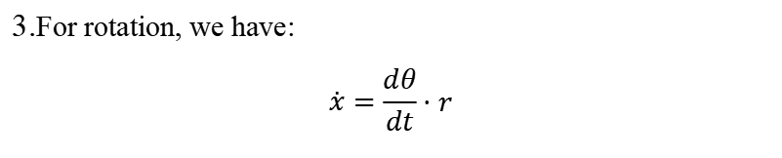
SYSTEM MODEL
Fig. 5 Force analysis of balance vehicle wheel steering balance.[1]
1.The voltage balance equation of the motor's excitation circuit and the torque balance equation on the shaft are as follows:
$$\begin{matrix}U_{a}=RI_{a}+U_{en} \\ U_{en}=k_{ε}ω=k_{ε}\frac{dθ}{dt} \\ C_{em}=k_{m}I_{R}\end{matrix}$$
2.Simultaneously, the relationship between the motor output voltage and torque is obtained as:
$$C_{em}=\frac{k_{m}\left(U_{a}−k_{ε}\frac{dθ}{dt}\right)}{R}$$
3.For rotation, we have:
$$\overset{˙}{x}=\frac{dθ}{dt}⋅r$$
4.Then
$$C_{em}=\frac{k_{m}\left(U_{a}−\frac{k_{ε}}{r}\overset{˙}{x}\right)}{R}$$

Slide 13
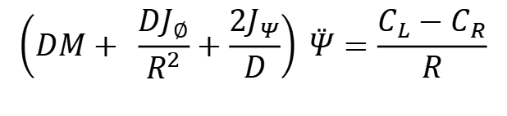
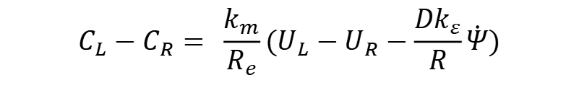
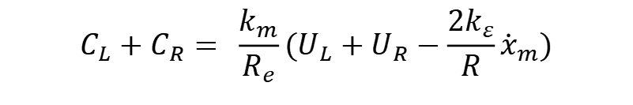
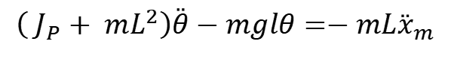
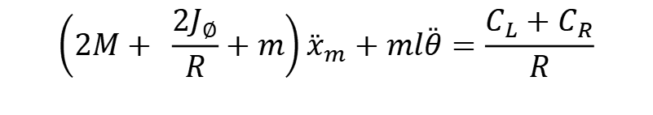
SYSTEM MODEL
To linearize the system, set:$sin⁡θ$ = $θ、cos⁡θ$ = $1{、\dot{θ}}^{2}\text{= 0}$
From the previous equations and linearization, we have:
Analysis on dynamics for the system:
Model for motors:
$$\left(2M+ \frac{2J_{∅}}{R}+m\right){\overset{¨}{x}}_{m}+ml\overset{¨}{θ}=\frac{C_{L}+C_{R}}{R}$$
$$C_{L}+C_{R}= \frac{k_{m}}{R_{e}}(U_{L}+U_{R}−\frac{{2k}_{ε}}{R}{\dot{x}}_{m})$$
$$\left(DM+ \frac{DJ_{∅}}{R^{2}}+\frac{2J_{Ψ}}{D}\right) \overset{¨}{Ψ}=\frac{C_{L}−C_{R}}{R}$$
$$C_{L}−C_{R}= \frac{k_{m}}{R_{e}}(U_{L}−U_{R}−\frac{{Dk}_{ε}}{R}\dot{Ψ})$$
$$\left( J_{P}+ mL^{2}\right)\overset{¨}{θ}−mglθ=−mL{\overset{¨}{x}}_{m}$$
Observe the turning velocity, inclination, inclination rate and speed.

Slide 14
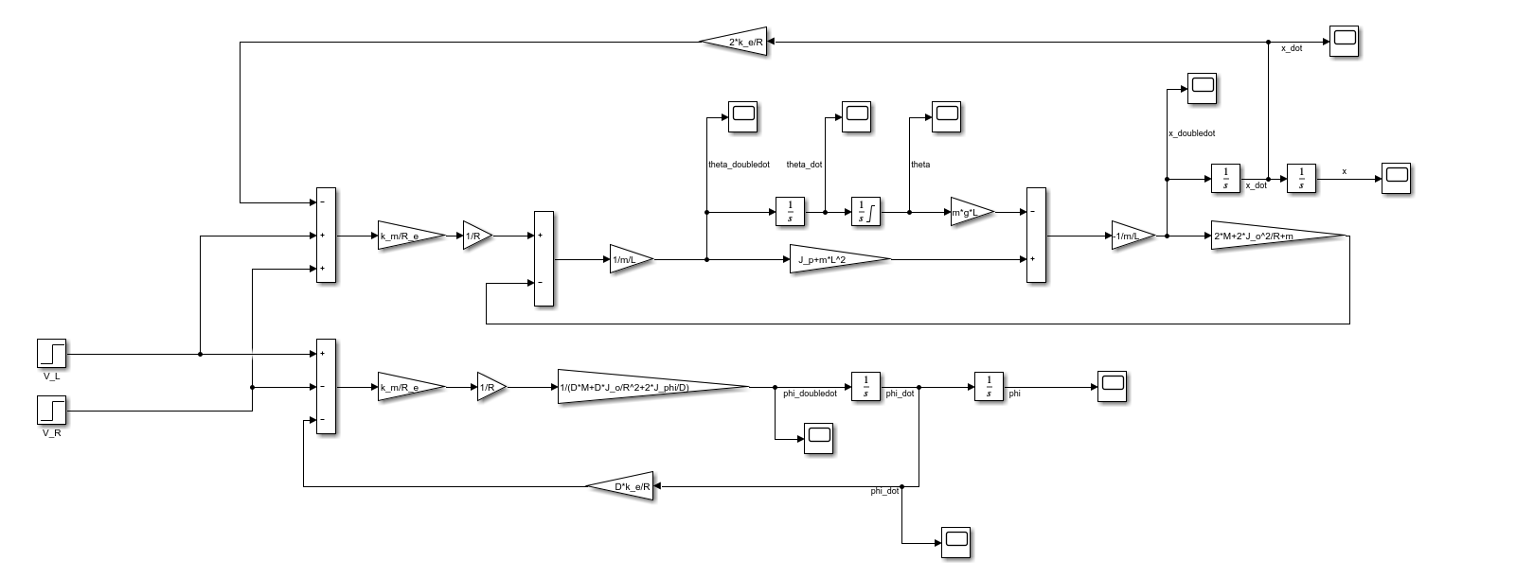
SYSTEM MODEL
Fig. 5 Simulink model of system

Slide 15
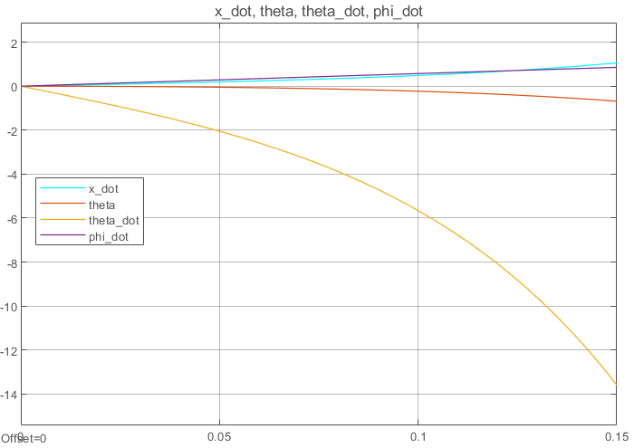
SYSTEM MODEL
With the parameters in [1], we can get the system response.
Unstable!
Fig. 6 System response

Slide 16
3
LQR
DESIGN

Slide 17
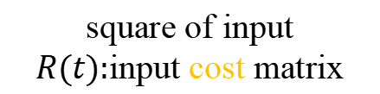
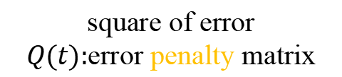
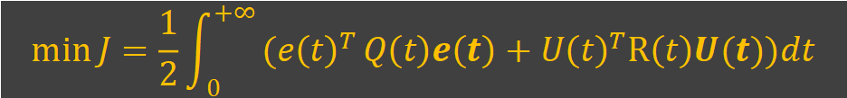
Linear Quadratic Regulator (LQR) Design
Linear Quadratic Regulator (LQR) Design
Linear System
Quadratic Cost Function (So we can find a minimum!)
$$\min{J=\frac{1}{2}\int_{0}^{+∞}{({e\left(t\right)}^{T}}Q\left(t\right)e\left(t\right)+{U\left(t\right)}^{T}R\left(t\right)U(t))dt}$$
square of error
$Q(t):$error penalty matrix
square of input
$R(t):$input cost matrix
Hamilton Function
$$H{=\frac{1}{2}{[Z−CX]}^{T}Q[Z−CX]+\frac{1}{2}U^{T}RU+λ^{T}(AX+BU)}$$

Slide 18
Linear Quadratic Regulator (LQR) Design
Hamilton Function
$$H{=\frac{1}{2}{[Z−CX]}^{T}Q[Z−CX]+\frac{1}{2}U^{T}RU+λ^{T}(AX+BU)}$$
Optimal Equation
Set$λ{=KX−GZ}$, we have
State Equation
Constate Equation

Slide 19
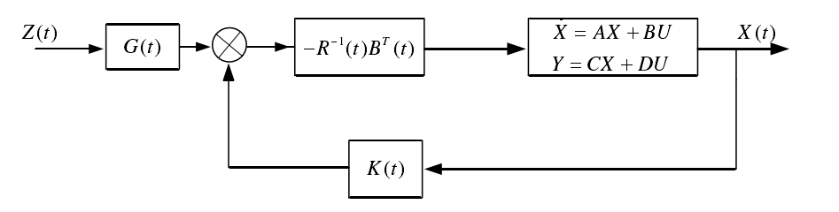
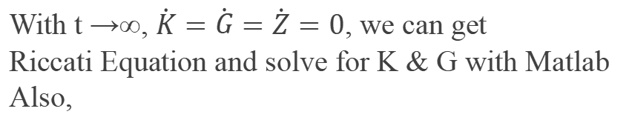


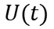
Linear Quadratic Regulator (LQR) Design
Substide $\dot{X}$ in, we have
With t →∞, $\dot{K}=\dot{G}=\dot{Z}=0$, we can get
Riccati Equation and solve for K & G with Matlab
Also,
$$U∗=R^{−1}B^{T}KX−R^{−1}B^{T}GZ$$
Block Diagram:
Gain of forward channel
State space of the system
-
$$U(t)$$
+
Gain of feedback channel

Slide 20
4
SIMULATION
AND
RESPONSE

Slide 21
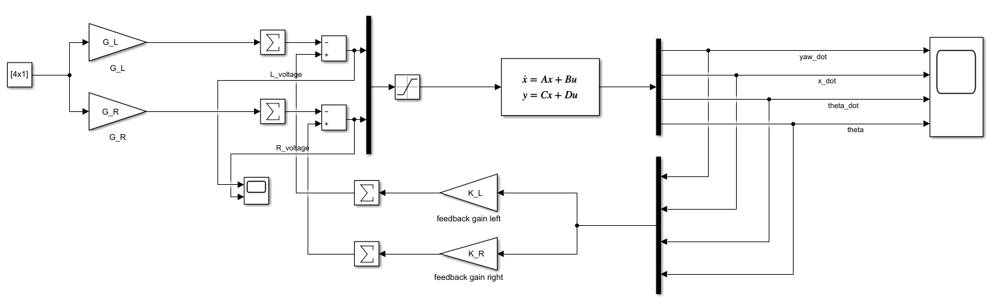
SIMULATION AND RESPONSE
Model 1: Constant input
Reference input signal: Desired angular velocity of yaw$\dot{ψ}$, velocity of the car $\dot{x}$, swing angle $θ$and its angular velocity $\dot{θ}$.
Output signal: state variables of the system. Actual value of the variables above.
Control signal: Voltage of the left and right motors.

Slide 22
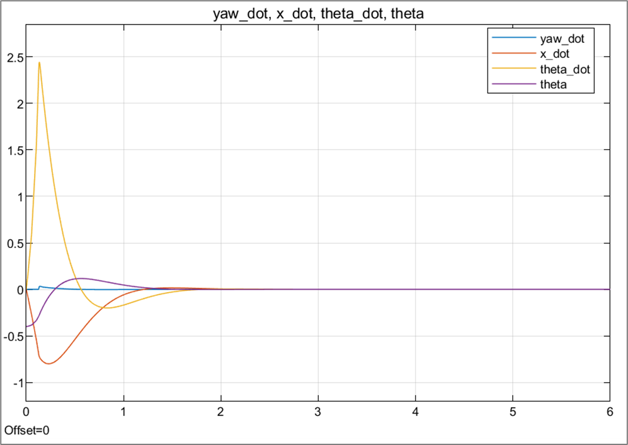
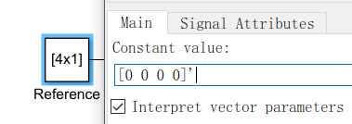
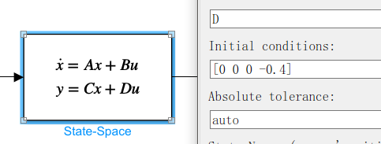
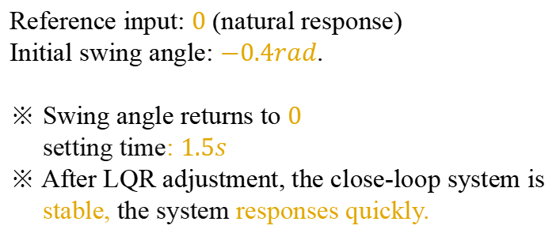
SIMULATION AND RESPONSE
1. Balance Control
Give the system a initial swing angle and see whether the vehicle can be balanced at last.
Reference input: $0$ (natural response)
Initial swing angle: $−0.4rad$.
※ Swing angle returns to $0$
setting time: $1.5s$
※ After LQR adjustment, the close-loop system is
stable, the system responses quickly.

Slide 23
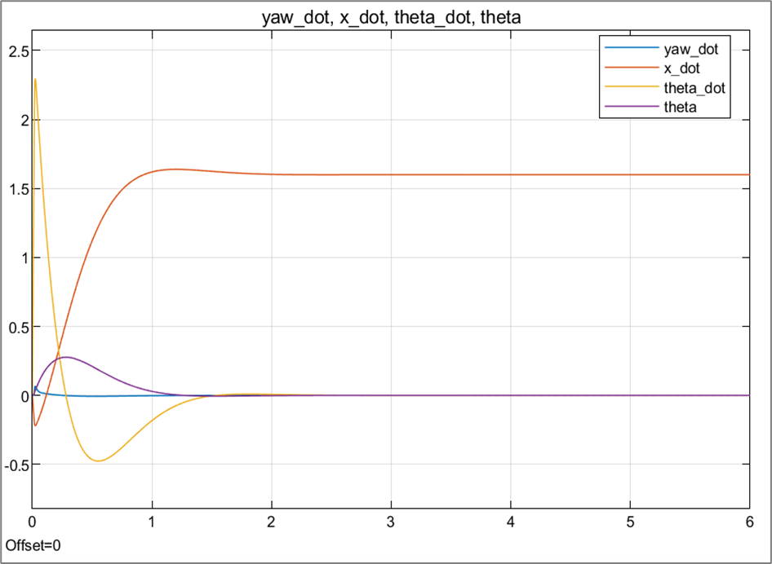
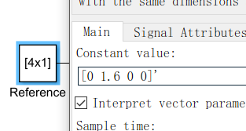
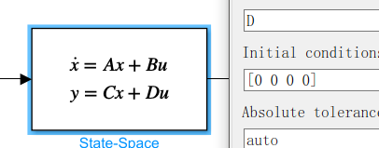
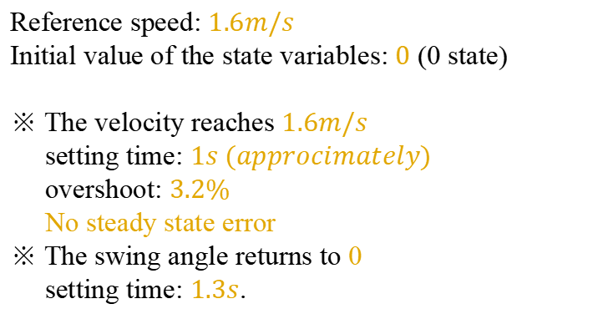
SIMULATION AND RESPONSE
2. Speed Control
Give a reference speed and see whether the vehicle can reach that value at last.
Reference speed: $1.6m/s$
Initial value of the state variables: $0$ (0 state)
※ The velocity reaches $1.6m/s$
setting time: $1s (approcimately)$
overshoot: $3.2\%$
No steady state error
※ The swing angle returns to 0
setting time: $1.3s$.

Slide 24
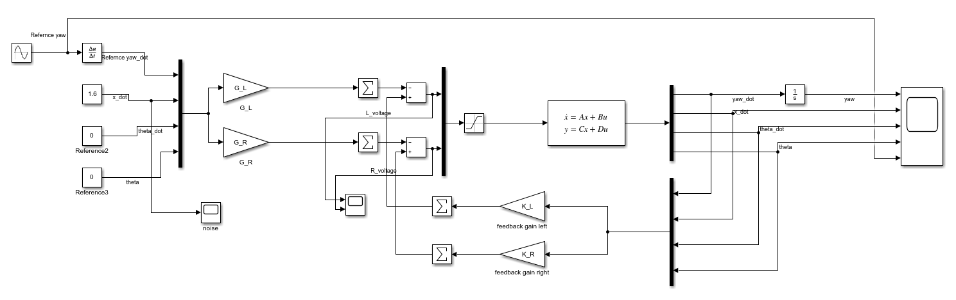
SIMULATION AND RESPONSE
Model 2: Time-varying input
Reference input signal: Desired yaw angle varies with time.

Slide 25
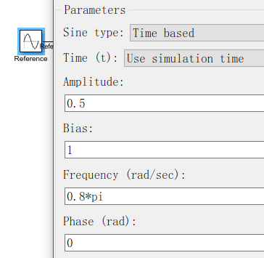
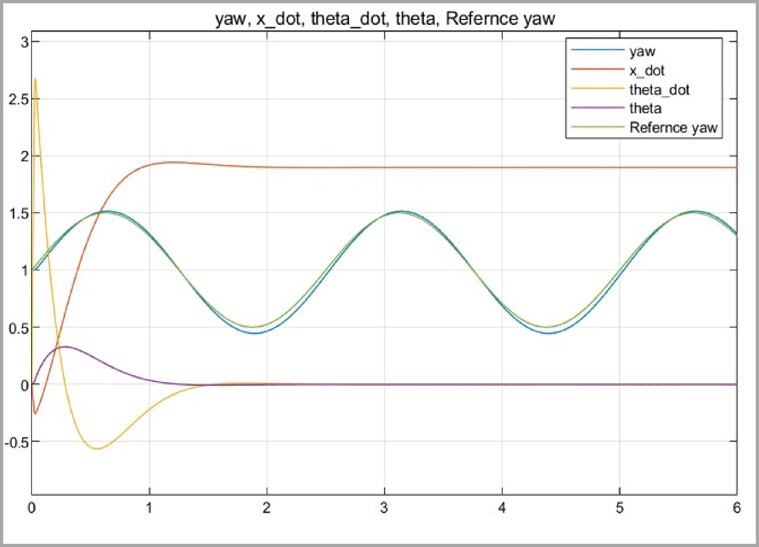
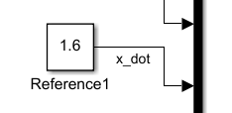
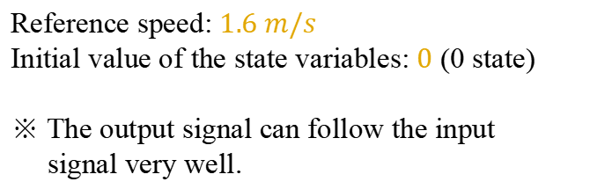
SIMULATION AND RESPONSE
3. Tracking Control
Give a reference yaw angle varying with time and see whether the vehicle can track that value.
Reference yaw angle: $1+0.5sin⁡(0.8pi∗t) rad$
Reference speed: $1.6 m/s$
Initial value of the state variables: $0$ (0 state)
※ The output signal can follow the input
signal very well.

Slide 26


SIMULATION AND RESPONSE
3. Tracking Control
※ The voltages of left and right motor are
like twisted-pair.
※ The vehicle can turn flexibly.
Figure of control signal

Slide 27

SIMULATION AND RESPONSE
Model 3: Impulse input
Reference input signal: velocity is an impulse signal.

Slide 28



SIMULATION AND RESPONSE
4. Robustness
Reference velocity: $δ(t)$
Duration:$1s$
※ The swing angle of the car suddenly increases, and the angular velocity increases.
※ After $1.5s$, the state variables are all $0$. ※ The robustness of the car is good.
Stable, accurate, response quickly

Slide 29
5
MEMBERS’
CONTRIBUTION

Slide 30
MEMBERS’ CONTRIBUTION
Song Yuchen: Theoretical Derivation & Design of LQR Controller
Tian Ruoyao: Model Simulation & Close-loop Response Analysis
He Run: System Modeling & Response
Zeng Jialong: Research & Modeling
Feng Yifan : PPT Production
Yan Hongjiao: Background Introduction

Slide 31
REFERENCE
[1] E. Pan. Design and implementation of two-wheeled self-balancing vehicle based on STM32 [ D ]. Heilongjiang : Heilongjiang University, 2018.
[2] https://zhuanlan.zhihu.com/p/479967321
[3] https://zhuanlan.zhihu.com/p/139145957
[4] https://www.cnblogs.com/yifanrensheng/p/12639539.html
[5] https://zh.wikipedia.org/wiki/LQR%E6%8E%A7%E5%88%B6%E5%99%A8
[6] https://zh.wikipedia.org/zhcn/%E4%BB%A3%E6%95%B8Riccati%E6%96%B9%E7%A8%8B
[7] R. Babazadeh, A. G. Khiabani and H. Azmi, "Optimal control of Segway personal transporter," 2016 4th International Conference on Control, Instrumentation, and Automation (ICCIA), 2016, pp. 18-22.

Slide 32
THANKS FOR YOUR LISTENING

Slide 33
Q&A

